Slide 1



Where is my Blood
Project Presentation
Md. Ashraful Hasan
2019-1-60-219

Slide 2







Introduction
Where is my Blood? (WIMB)
A small effort to contribute to the fragile health service
Digitizing and augmenting the current
process to ﬁnd donors
A internet based application handling interaction between different users involved in the process of blood donation
BLOOD?

Slide 3



User Requirements
High Priority
Finding eligible and active Donors
according to necessary ﬁlters
Authentication of Users
Placing Donation Request
Update last donate report
Requirements based on the data collected through survey

Slide 4


User Requirements
Update Personal Information
Keeping Track of the previous
Donation Requests
Searching for doner
Medium Priority
View Donation History
All Pending Requests in a list
Low Priority

Slide 5
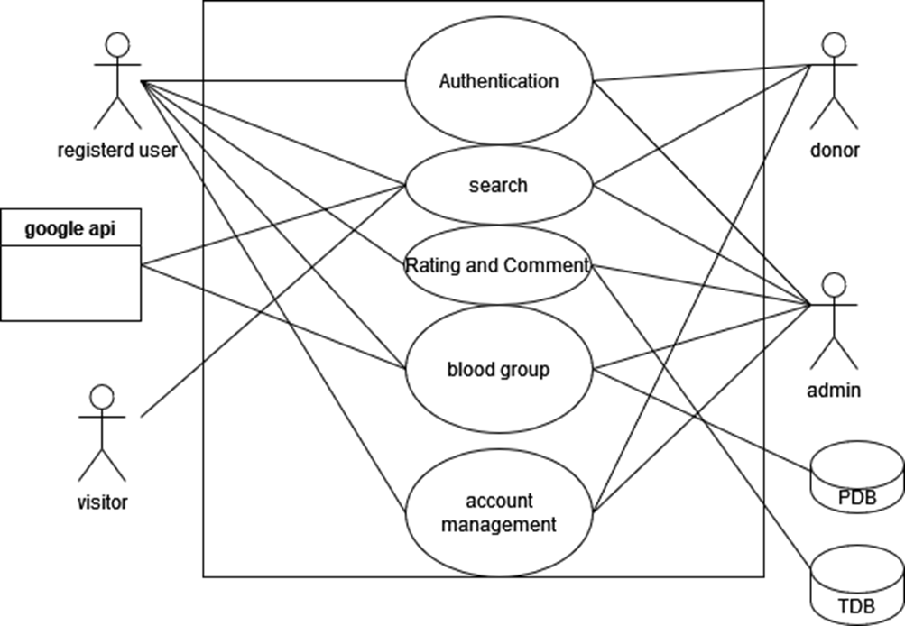
Use Case Diagram

Slide 6
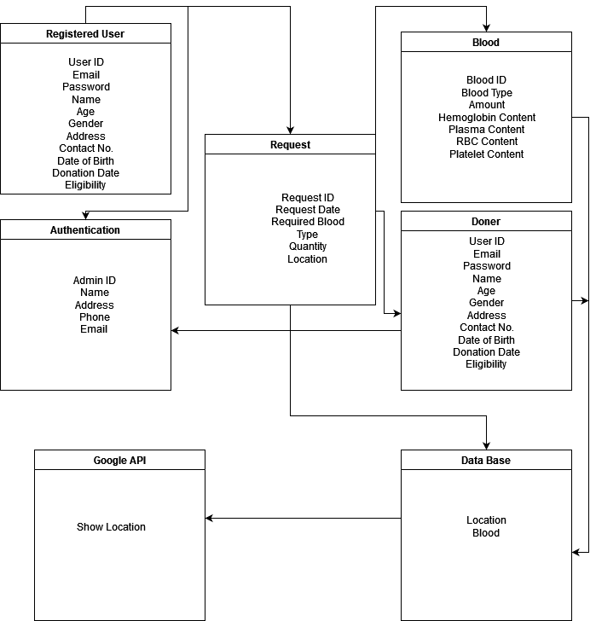
Class Diagram

Slide 7
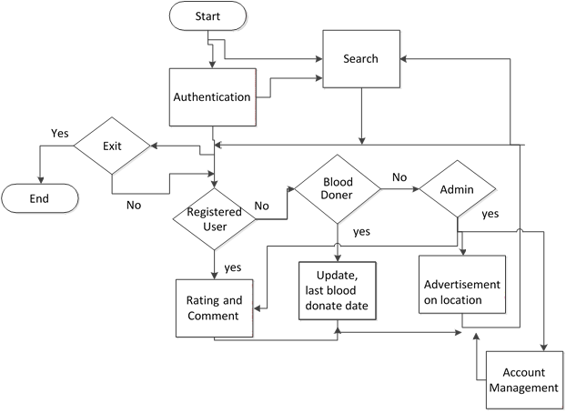
Activity Diagram

Slide 8
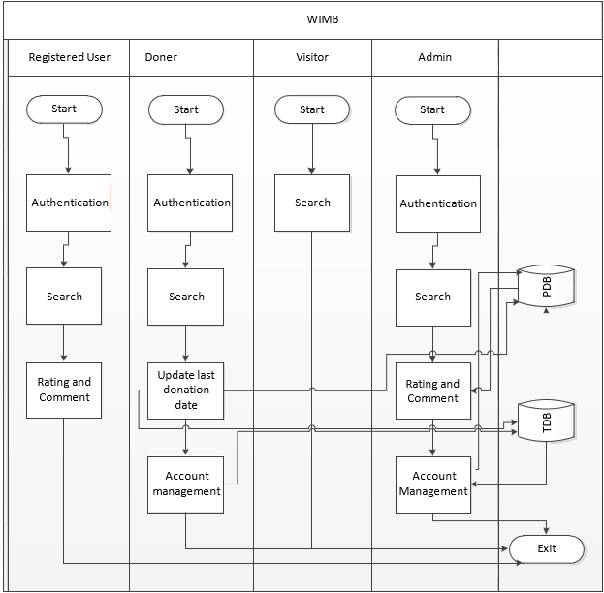
Swim lane Diagram

Slide 9
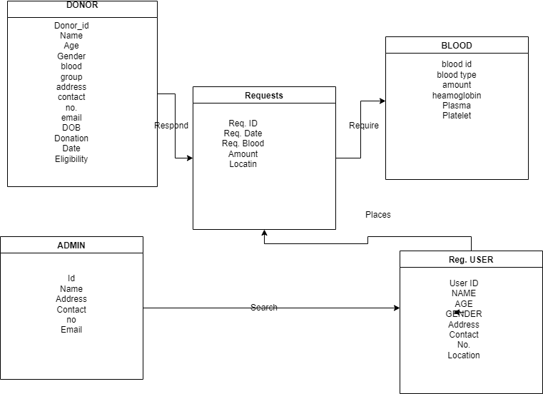
ER Diagram

Slide 10


Features
Implemented
Sign up/in of Users
Update information
Change Password
Searching Donor & Blood
Donation request
View Donation and Request History
Admin Proﬁle to review users

Slide 11
Will Upgrade
Not Implemented yet
Plasma bank
Component-wise donor management
Giving reward with mobile banking
Under Implementation

Slide 12
Thank You

